Slide 1
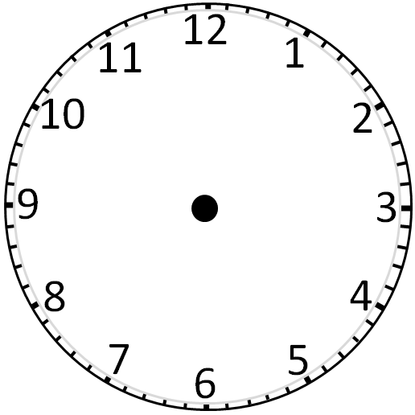
C
L
O
C
K
F
A
C
E
S
U
M
S
Divide the clock face into three parts by drawing two straight lines in such a way that the sum of the numbers in each part are equal.
Sum of numbers from 1 to 12 = 78
78/3 = 26

Slide 2
Worksheet

